Slide 1


SPARK for Security
Yannick Moy – AdaCore
ETH Zurich – May 3, 2018

Slide 2
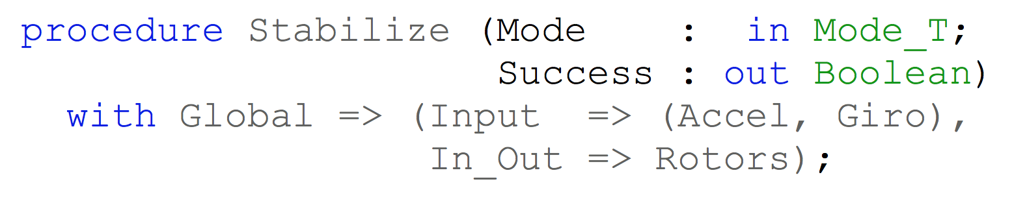
SPARK – Flow Analysis
Specification of effects
Flow analysis
Program implements specification

Slide 3
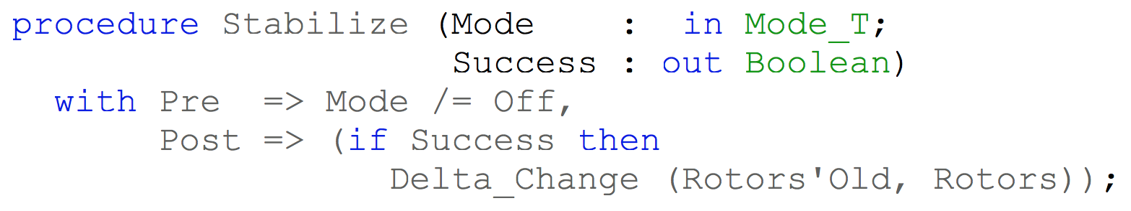
SPARK – Proof
Specification of properties
Proof
Program implements specification

Slide 4



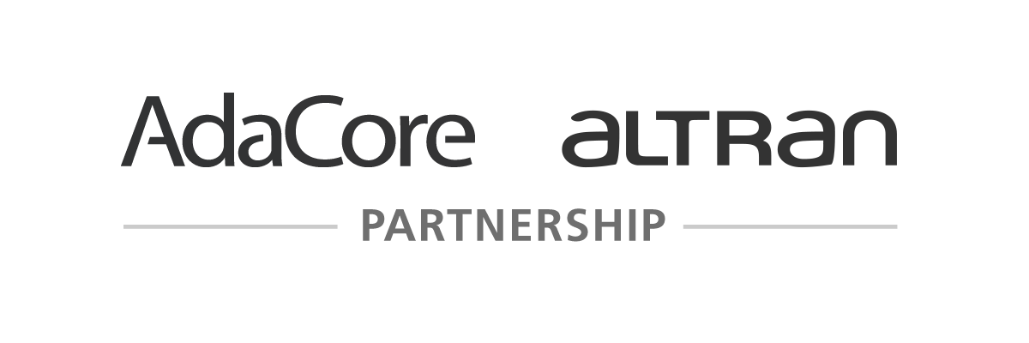
Historical Perspective
1987
SPARK
PVL
2008
1997
C130J
2005
Tokeneer
2011
iFACTS
2013
Muen
Are We There Yet? 20 Years of Industrial Theorem Proving with SPARK, Chapman and Schanda, Altran, ITP 2014

Slide 5
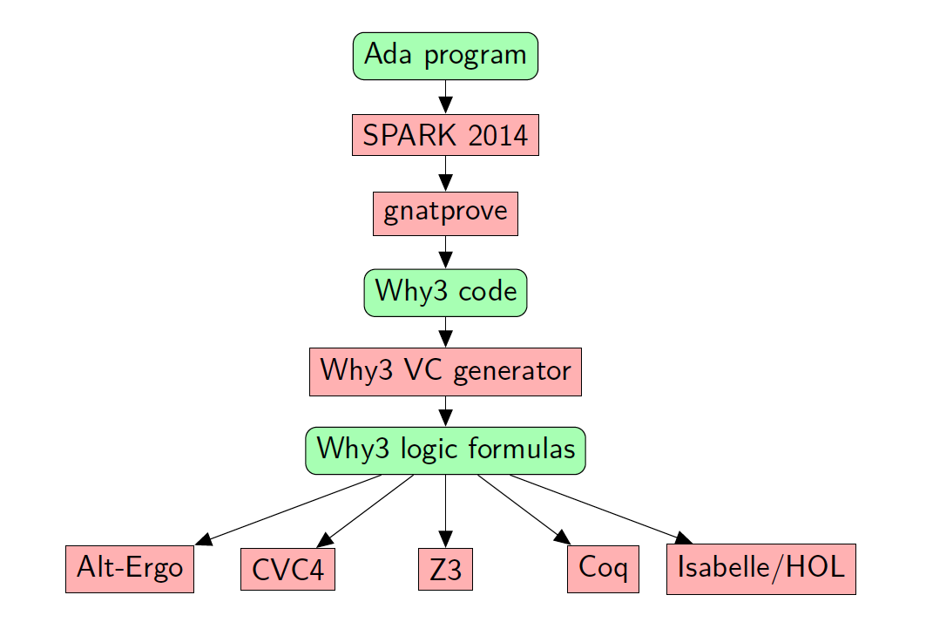

SPARK Open Source Ecosystem

Slide 6
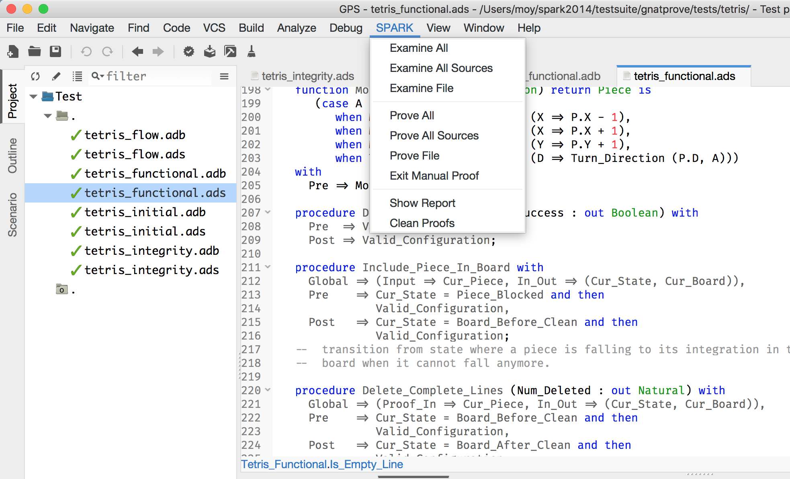
Key Features - Integration
Build-Test-Prove
all in the same IDEs

Slide 7
Key Features - Integration
Contracts are code

Slide 8
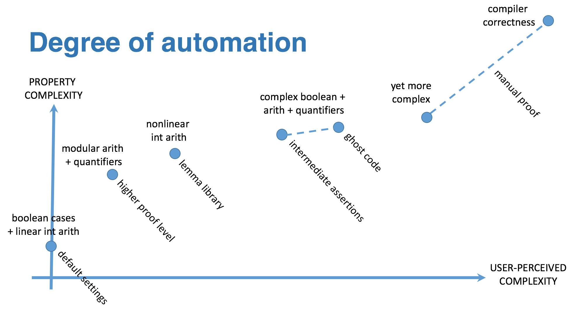
Key Features - Automation

Slide 9
Key Features - Interaction
Path
Counterexample

Slide 10
SPARK Programming Language

Slide 11
SPARK – a Subset of Ada
strong typing
low level programming
generics
object orientation
concurrency
Abstract_State
Initializes
Initial_Condition
Contract_Cases
Global
Depends
pointers
exception handlers
controlled types
function with effects
Ada
features outside
the SPARK subset
Core language constructs common to Ada and SPARK
Additional SPARK aspects
Ada
SPARK

Slide 12

SPARK – a Simple Example
procedure Increment (X : in out Integer) with Global => null, Depends => (X => X), Pre => X < Integer'Last, Post => X = X'Old + 1; procedure Increment (X : in out Integer) is begin X := X + 1; end Increment;
data dependencies
flow dependencies
functionality
absence of runtime error

Slide 13
SPARK – Subprogram Contracts
function Find (A : Nat_Array; E : Natural) return Natural with Post => Find’Result in 0 | A’Range; function Find (A : Nat_Array; E : Natural) return Natural with Post => (if (for all I in A’Range => A (I) /= E) then Find’Result = 0 else Find’Result in A’Range and then A (Find’Result) = E);

Slide 14
SPARK – Type Contracts
function Is_Sorted (A : Nat_Array) return Boolean is (for all I in A’Range => (if I < A’Last then A (I) <= A (I + 1))); -- Returns True if A is sorted in increasing order. subtype Sorted_Nat_Array is Nat_Array with Dynamic_Predicate => Is_Sorted (Sorted_Nat_Array); -- Elements of type Sorted_Nat_Array are all sorted.

Slide 15
SPARK – Expression Functions
function Is_Empty (B : Board; Y, X : Integer) return Boolean is (X in X_Coord and then Y in Y_Coord and then B(Y)(X) = Empty); function No_Overlap (B : Board; P : Piece) return Boolean is (case P.S is when O => Is_Empty(B,P.Y,P.X) and then Is_Empty(B,P.Y,P.X+1) and then Is_Empty(B,P.Y+1,P.X) and then Is_Empty(B,P.Y+1,P.X+1), when I => (for all Y in I_Delta => (for all X in I_Delta => (if Possible_I_Shapes(P.D)(Y,X) then Is_Empty(B,P.Y+Y,P.X+X)))), when Three_Shape => … );

Slide 16
SPARK – Loop Invariants
A_I : constant Nat_Array := A with Ghost; for K in A’Range loop A (K) := F (A (K)); pragma Loop_Invariant (for all J in A’First .. K => A(J) = F(A’Loop_Entry(J))); -- info: loop invariant initialization proved -- info: loop invariant preservation proved end loop; pragma Assert (for all K in A’Range => A(K) = F(A_I(K))); -- info: assertion proved

Slide 17
GNATprove Internals

Slide 18
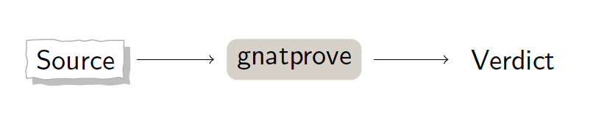
GNATprove – User View

Slide 19
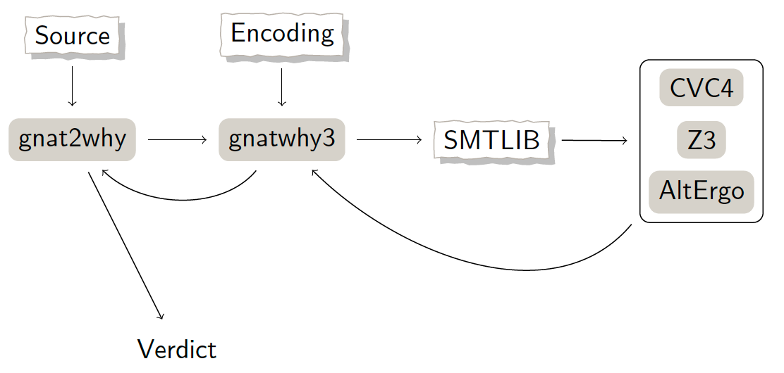
GNATprove – Architecture (1/2)

Slide 20
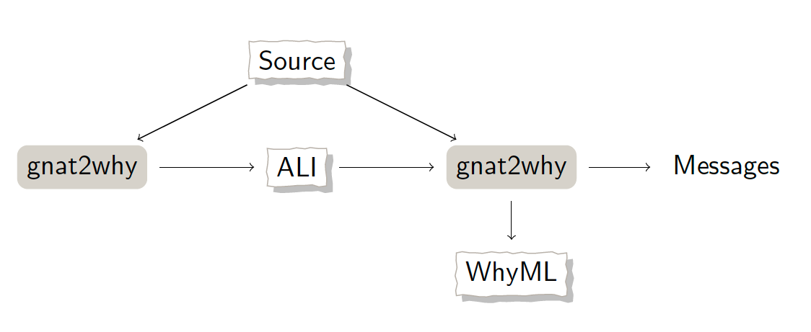
GNATprove – Architecture (2/2)

Slide 21
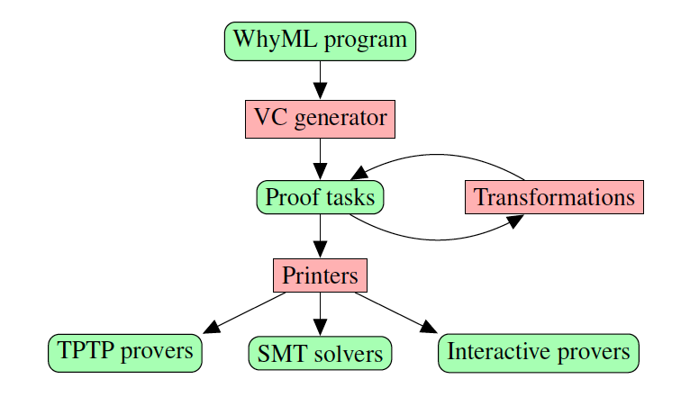
Why3 – Architecture

Slide 22
GNATprove – Solved Technical Difficulties
Combination of SPARK and Ada code – SPARK_Mode aspect/pragma, “auto” mode on specs, generation of Global
Minimize rework – file timestamps, VC hashes, semantic dependencies, persistent database, integration with memcached, VC shapes
Exploit multicore – concurrent analysis of files, VC server
Soundness of Why3 modeling – realization of models in Coq (floats, bitvectors, arrays, integers), switch to models in contracts (containers), guarded axioms for functions
User feedback on unproved VC – VC splitting, trace and counterexample

Slide 23
GNATprove – Ongoing Technical Difficulties
State abstraction – interactions with visibility and SPARK/Ada boundary
Integration of manual proof – bridge to Isabelle/Coq, manual proof feature at code level
Proof of floating-point programs – Z3 native support, CodePeer static analysis, experiments with Alt-Ergo/Colibri/CVC4
Proof of non-linear arithmetic properties – bitvector support in Z3/CVC4 for modular types, lemma library proved in Coq
Overall tool soundness – interface with specialized engines (Why3 VCgen, SMT provers), sharing frontend between compiler/analyzer, experiment with proof of check placement in Coq

Slide 24
Soundness

Slide 25
Unsoundness Story #1 – Constants in Loops
July 16, 2013 – developer discovers unsoundness in translation into Why3 of constants inside loops – combination of loop handling when loop invariant not at loop start and assumptions for dynamic constants – fix by removing assumptions, using variables in Why3 instead
July 31, 2014 – another developer discovers the issue again – changes in the translation of arrays/records have introduced new constants – fix by restrictions on declarations inside loops before loop invariant
July 19, 2017 – same developer remarks that loop unrolling feature has reintroduced the issue for two days – fix by not unrolling problematic loops

Slide 26
Unsoundness Story #2 – Why3 Fast WP
Dec 13, 2012 – implementation of fast WP feature in Why3, based on “Efficient Weakest Preconditions” by Leino (2004) later added to Why2 (circa 2008) – use optimization from Why2 for scalability to reduce number of symbols
Jan 21, 2014 – unsoundness on internal test related to optimization – algorithm incorrect in presence of exceptional paths – fix to special-case exceptional paths
May 20, 2017 – unsoundness on user code related to incomplete fix – merges of exceptional paths must retain special-case

Slide 27
Unsoundness Story #3 – SMT Provers
2011: Alt-Ergo issue (before bug tracker) – unsoundness with name capture
2014: CVC4 issue #583/#802 – unsoundness in quantifier instantiation
2014: CVC4 issue #599/#818 – unsoundness related to use of rlimit
2015: Z3 issue #183 – unsoundness related to MBQI
2016: Alt-Ergo issue #17 – unsoundness on division of negative numbers
2016: Z3 issue #508 – unsoundness of fp.rem on denormal numbers
2018: Z3 issue #1520 – unsoundness on bitvectors and integers
No other open unsoundness issues in Alt-Ergo, CVC4, Z3 issue trackers

Slide 28
Levels of Software Assurance

Slide 29
Stone Level
Strong semantic coding standard
Program respects all the SPARK language legality rules
Enforces safer use of language features:
Restricted concurrency (Ravenscar profile)
Expressions and functions without side-effects
Forbids language features that make analysis difficult:
Unrestricted pointers
Exception handlers

Slide 30
Bronze Level
Initialization and correct data flow
Program passes SPARK flow analysis without violations
Detects programming errors:
Read of uninitialized data
Problematic aliasing between parameters
Data race between concurrent tasks
Checks user specifications:
Data read or written
Flow of information from inputs to outputs

Slide 31
Silver Level
Absence of run-time errors
Program passes SPARK proof without violations
Detects programming errors:
Divide by zero
Array index out of bounds
Integer, fixed-point and floating-point overflow
Integer, fixed-point and floating-point range violation
Explicit exception raised
Violation of Ceiling Priority Protocol

Slide 32
Gold Level
Proof of key integrity properties
Program passes SPARK proof without violations
Checks user specifications:
Type invariants (weak and strong)
Preconditions
Postconditions
Checks correct use of OO wrt Liskov Substitution Principle

Slide 33
Platinum Level
Proof of full functional correctness
Program passes SPARK proof without violations
Checks complete user specifications:
Type invariants (weak and strong)
Preconditions
Postconditions
Checks loop termination (loop variant)

Slide 34
Software Assurance Levels

Slide 35
Features that Matter

Slide 36
Stone Level – Large Language Subset
SPARK_Mode => On
Ada types, expressions, statements, subprograms
SPARK_Mode => Off
Ada pointers
Ada exception handlers
Ada generics
Ada object orientation
Ada concurrency
SPARK_Mode => On
Ada types, expressions, statements, subprograms
SPARK_Mode => Off
Ada pointers
Ada exception handlers
Ada generics
Ada object orientation
Ada concurrency

Slide 37
Stone Level – Large Language Subset
SPARK_Mode => On
Ada types, expressions, statements, subprograms
SPARK_Mode => Off
Ada pointers
Ada exception handlers
Ada generics
Ada object orientation
Ada concurrency
Ada pointers
SPARK_Mode => On
Ada types, expressions, statements, subprograms
SPARK_Mode => Off
Ada pointers
Ada exception handlers
Ada generics
Ada object orientation
Ada concurrency
work in progress to include safe Rust-like pointers in SPARK

Slide 38
Bronze/Silver Level – Generation of Contracts
Example: SPARKSkein Skein cryptographic hash algorithm (Chapman, 2011)
target: Silver level
initial version (SPARK 2005) | current version (SPARK 2014)
41 non-trivial contracts for effects and dependencies | 1 – effects and dependencies are generated
31 conditions in preconditions and postconditions on internal subprograms | 0 – internal subprograms are inlined
43 conditions in loop invariants | 1 – loop frame conditions are generated
23 annotations to prevent combinatorial explosion | 0 – no combinatorial explosion

Slide 39
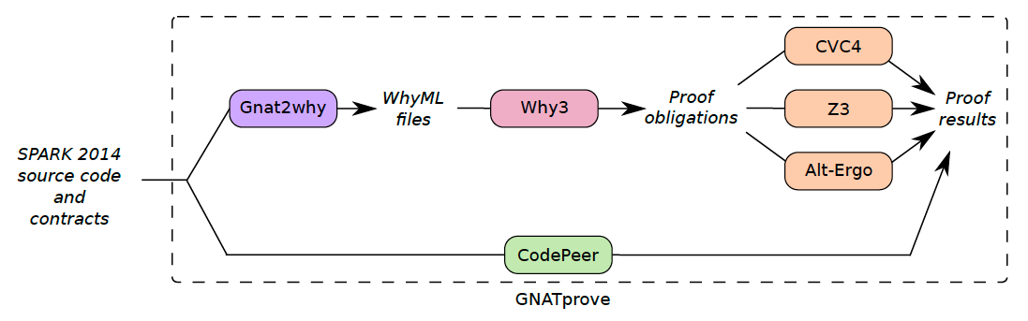
Silver/Gold Level – Combination of Provers

Slide 40
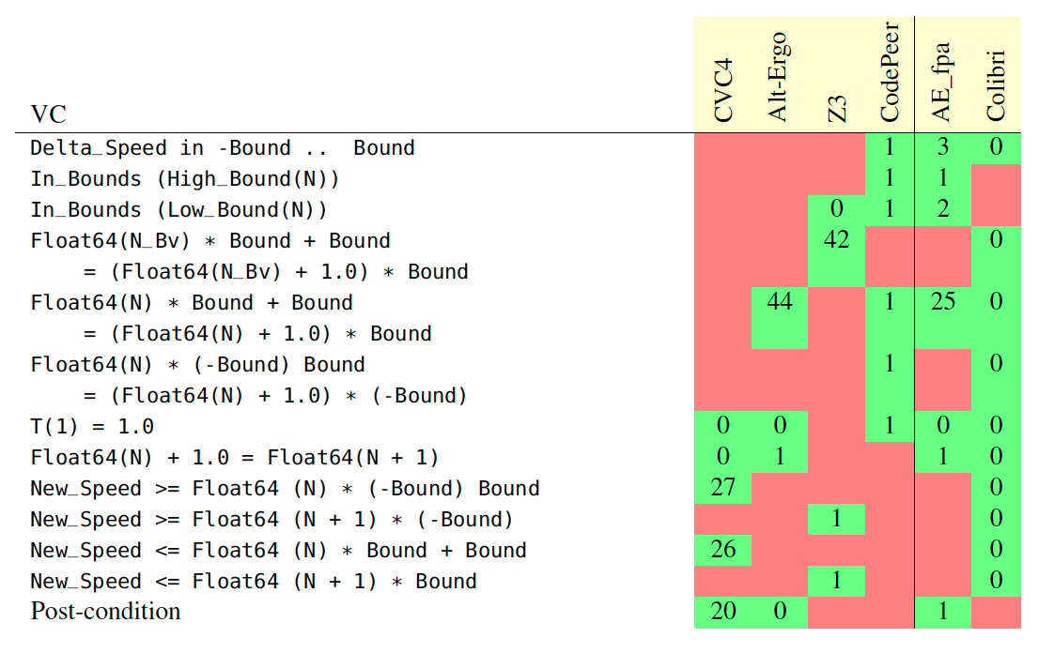
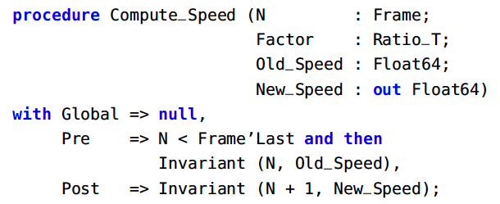
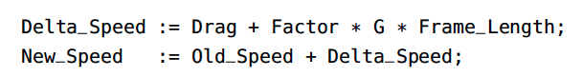
Silver/Gold Level – Combination of Provers
Example: Safe bounds on trajectory computation (submitted to VSTTE 2017)
target: Gold level

Slide 41
Gold/Platinum Level – Auto-Active Verification
Example: Functional correctness of red-black trees (NFM 2017)
target: Platinum level
Auto-Active = portmanteau of Automatic and interActive
supported by ghost code: contracts, loop invariants,
intermediate assertions, lemma procedures
ghost code used to:
define model of data used in specifications
prove intermediate lemmas (e.g. for inductive proofs)
provide witness for property (e.g. for transitivity relation)
2
1
4
3
5

Slide 42
Gold/Platinum Level – Auto-Active Verification

Slide 43
Open Source Security Projects

Slide 44


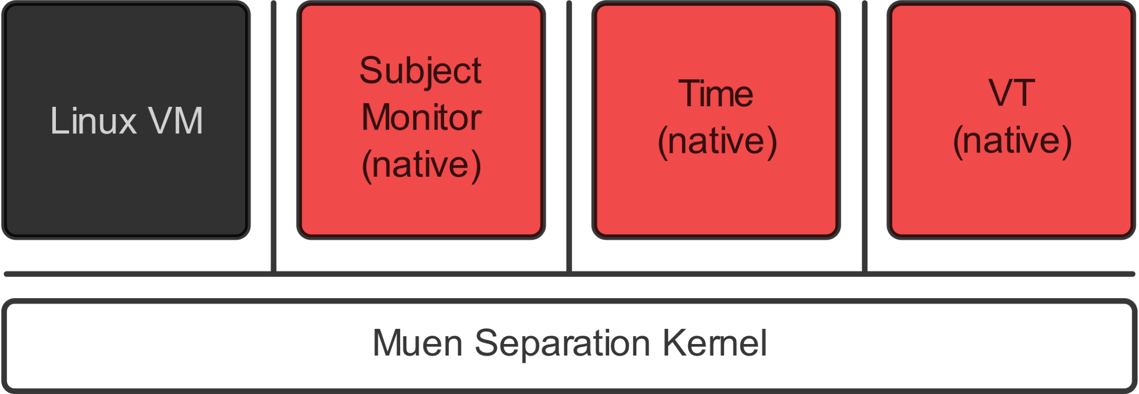
Muen Separation Kernel
The Muen Separation Kernel is the world’s first Open Source microkernel that has been formally proven to contain no runtime errors at the source code level.
Runs on Intel x86/64 platform - developed at University of Rapperswil (Switzerland) with secunet (Germany)

Slide 45
Muen Separation Kernel
https://muen.sk/
2014 –
Linux subject support
Migration to SPARK 2014
2016 –
Windows support via VirtualBox/Genode
2018 – MirageOS subject support
2013 – 1st release
3000 sloc SPARK
300 sloc assembly
2015 – Genode subject support
2017 – release 0.9
project website runs on
MirageOS on Muen!

Slide 46
Muen vs. Meltdown/Spectre
Muen not vulnerable to Meltdown: Meltdown is defended by our design decision to have a simple architecture which only utilizes a single isolation mechanism: hardware virtualization.
https://groups.google.com/forum/#!topic/muen-dev/1ILwIz8h-kM
Muen kernel little vulnerable to Spectre: The Muen kernel is affected by Spectre (one indirect jump in debug build, one indirect access after range check). The observed issues can be fixed with small local changes and no architectural modifications.
Subject might be vulnerable, require counter measures in kernel.
https://groups.google.com/forum/m/#!topic/muen-dev/4tC3MbPxTOQ

Slide 47

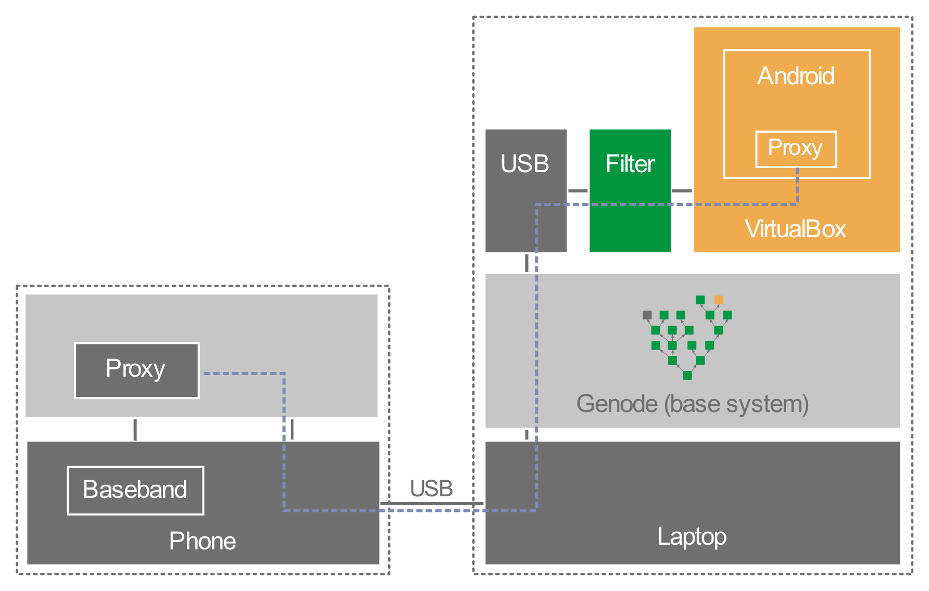
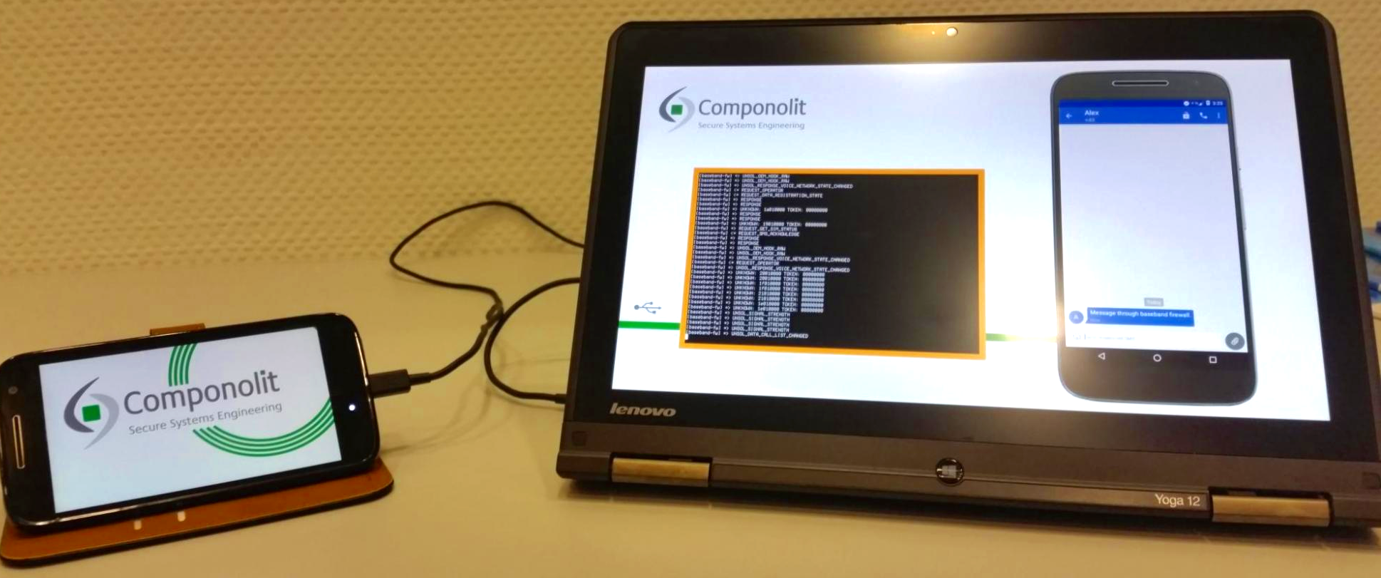
Componolit Secure Phone
Aim at building a trustworthy mobile OS based on Genode + SPARK

Slide 48
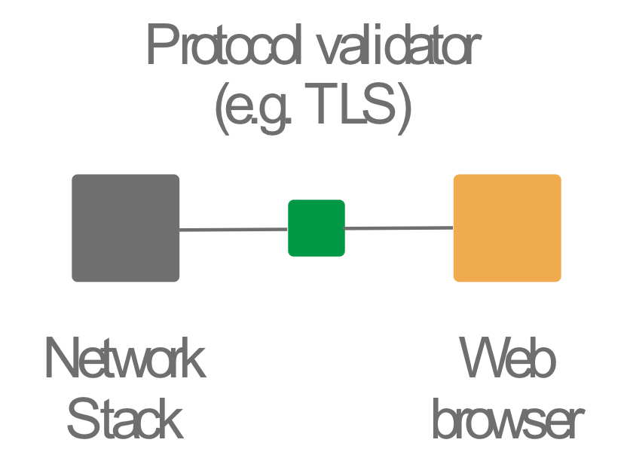
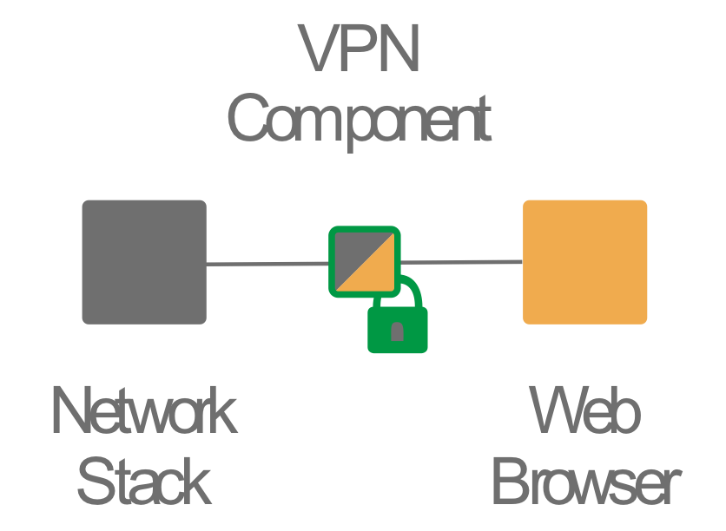
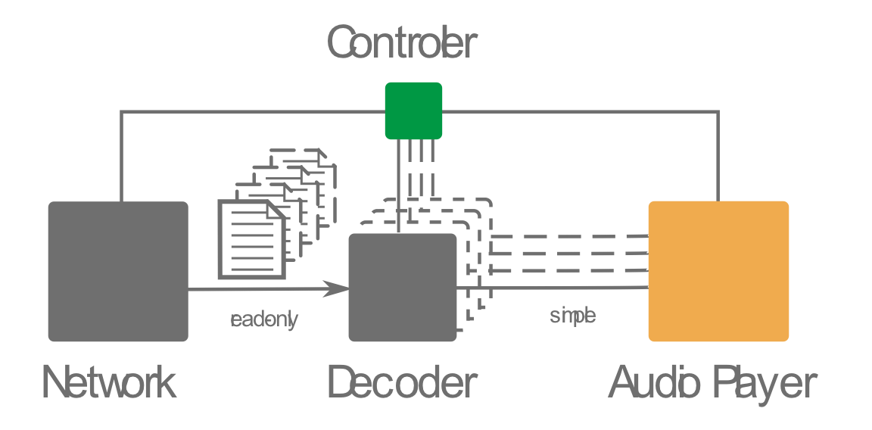
Componolit Secure Phone
https://github.com/Componolit
Genode provides isolation between trusted (green) and untrusted
SPARK provides confidence in trusted
Secure architectures: policy objects, trusted wrapper, transient component

Slide 49
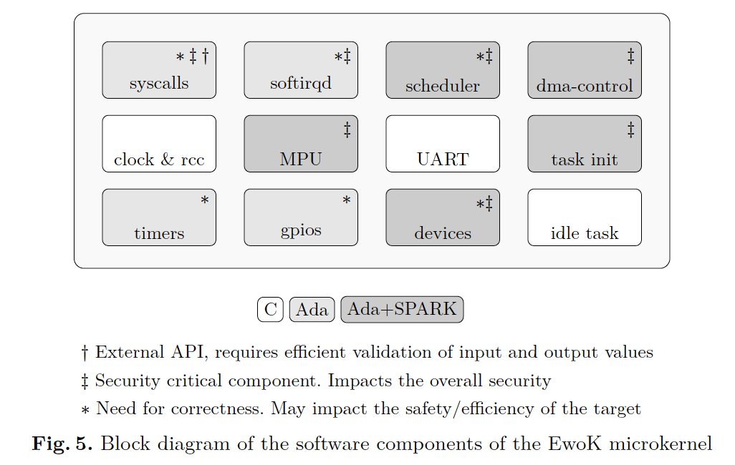
WooKey Secure USB Key
Answer to BadUSB threat disclosed in 2014
Custom STM32 USB thumb drive designed for security
Custom microkernel for security: MPU, safe languages, formal methods
Figure from the article accepted at SSTIC 2018 – “WooKey: USB Devices Strike Back”

Slide 50
Conclusion

Slide 51
SPARK for Security
SPARK supports 5 levels of increasing software assurance
From strong semantic coding standard to full functional correctness
Bronze level (correct information flow) is key for confidentiality
Silver level (AoRTE) is a must-have for secure software
SPARK can be combined with Ada at fine-grain (subprogram) level
SPARK can be combined with C at coarser-grain (file) level
Common Code Generator (CCG) generates C code from SPARK

Slide 52
SPARK Resources
SPARK toolset
http://www.adacore.com/sparkpro http:// www.adacore.com/community
SPARK adoption guidance
www.adacore.com/knowledge/technical-papers/implementation-guidance-spark
AdaCore Technologies for Cyber Security booklet
https://www.adacore.com/books/adacore-tech-for-cyber-security
SPARK reference documents (User’s Guide + Reference Manual)
https://www.adacore.com/documentation/#SPARK
SPARK online training
http://u.adacore.com

